Slide 1

How to Integrate Deep Learning Methods with Transportation Model Calibration: A Computational Graph-Based Approach with Multiple Data Sources
Xuesong (Simon) Zhou, xzhou74@asu.edu
School of Sustainable Engineering and the Built Environment
Arizona State University
Co-author: Dr. Xin (Bruce) Wu
xinwu3@asu.edu
Postdoc scholar at ASU

Slide 2


C
Challenges in planning modal calibration with multiple data sources
What is Deep Learning from our model calibration perspective?
What is layered computation graph anyway?
Steps for integrating ML/CG in 4-step model calibration
Simultaneous Forecasting Model Using an Econometric model +Deep Neural Network
Further extensions
ontents
Notes:
Challenges in planning modal calibration with multiple data sources
What is Deep Learning from our model calibration perspective?
What is layered computation graph anyway?
Steps for integrating ML/CG in 4-step model calibration
Simultaneous Forecasting Model Using Econometric model +Deep Neural Network
Extensions

Slide 3
Challenges in planning modal calibration with multiple data sources

Slide 4
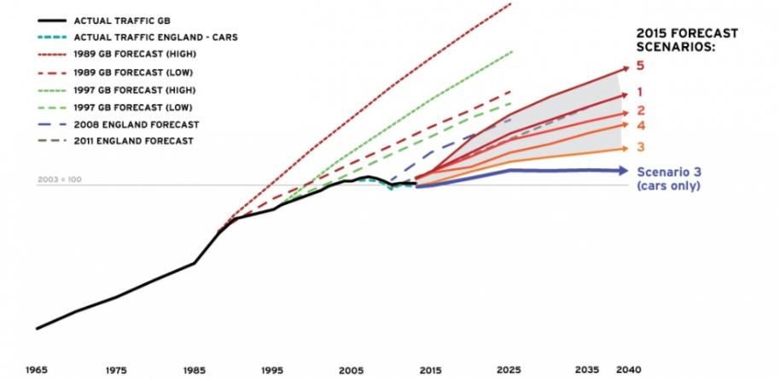
Introduction
Basic concepts
1. Traffic demand flow estimation (TDFE) problem
2. The simultaneous estimation problem of traffic demand flows and users behavior coefficients (TDFE-UB)
Trip generation→ Linear regression model given OD split rates and link proportion
OD Matrix →ODME problem, inverse process of four-step models
Path/Link flows→ Traffic assignment/ Stochastic network loading
Behaviors parameters (e.g. Value of time, VOT) → Discrete choice model
3. Multi-layer Hierarchical Flow Network (MHFN)→ Distributed deep network →神经网络
4 Big data driven transportation computational graph (BTCG) → 计算图

Slide 5
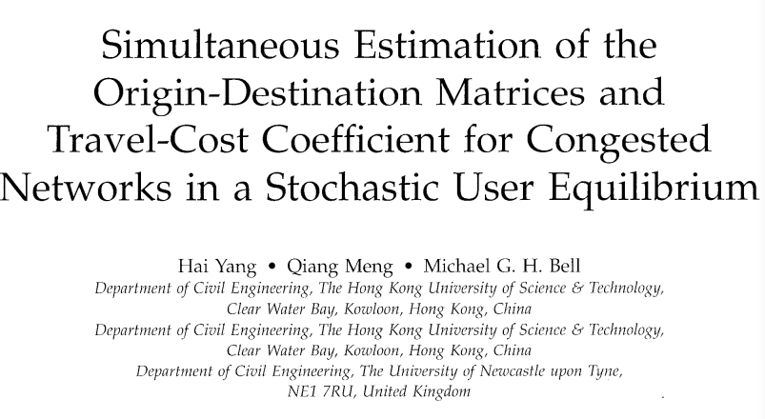

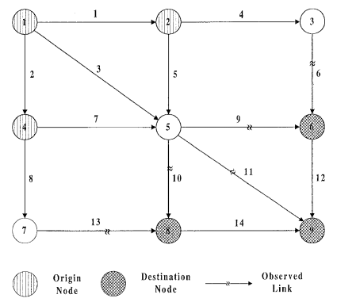
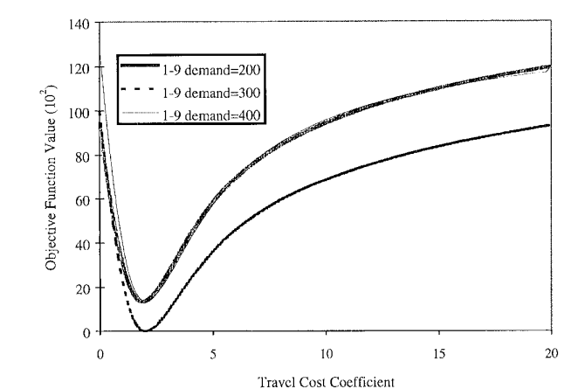
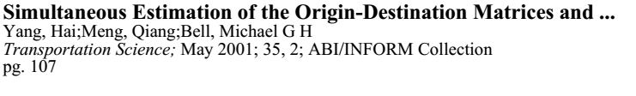
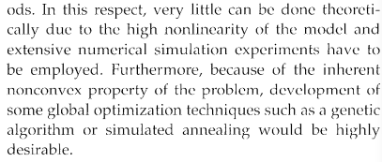
Theoretically satisfactory
$×$ Difficult to be solved
Problem is nonconvex

Slide 6
Introduction
Big data resources:
Household travel surveys
Empirical foundation of many classical models
Expensive and the period of surveys range from 5 to 10 years
Demographic characteristics
(2) Mobile phone data
Demographic biases (e.g. income or age bias)
The spatial granularity of phone data depends on the cell tower to which call records are mapped (often >100m, about 200m-2000m) .
Do not know traffic mode
Map matching process is limited by locational precision of cell-towers.
Sample penetration of the data

Slide 7
Introduction
Big data resources:
(3) Floating car data
Higher resolution than mobile phone data (time-dependent map matching)
Taxi and bus only
Low sample penetration of the data
(4) Sensor data
Underdeterminedness
Some links have not yet installed sensors.
Overfitting

Slide 8
Introduction
Big data resources:
Comparison of different data resources.
Characteristics | Household travel surveys | Mobile phone data | Floating car data | Sensor data
Time period | 5-10 years | Multi hour periods within the day | individual hours of the day | Per 15 minutes of the day
Demand Types | Aggregated | Aggregated | Aggregated sometime disaggregated traces | Aggregated
Sample penetration | Low | Depend on market share | Low | High
Precision | Zone-based | 200m-2000m | 1-10m | Link-based
Coverage Issues | High coverage | Coverage-limited | Coverage-limited | Coverage-limited
Demographic Bias | Affluent demographic information | Mild demographic bias | Severe demographic bias | Do not have demographic bias for car owners
Speed information | Not available | Not available | Available with varying degrees of processing effort | Generally available
Link/Corridor analysis | Not available | Not available | Limited available | Available
Data collecting cost | Expensive | Inexpensive | Inexpensive | Inexpensive

Slide 9
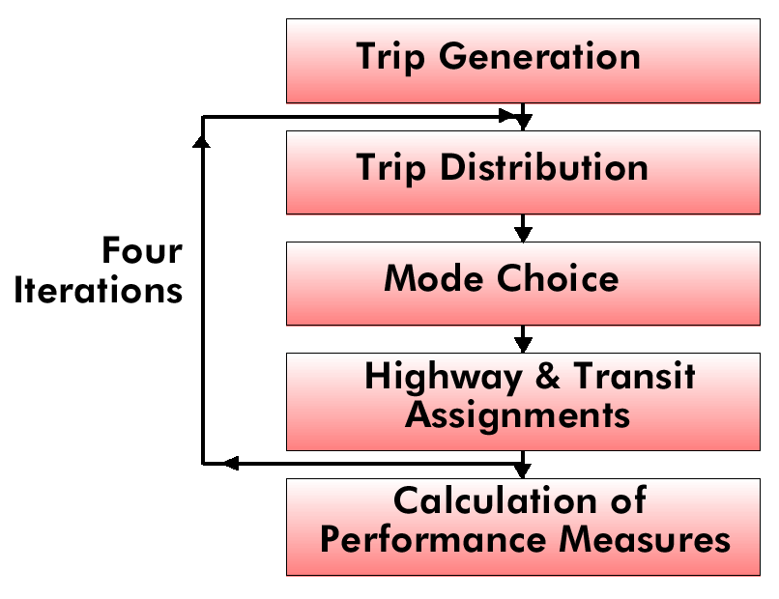
4-step process in transportation modeling
Land use
Zonal Demographics
Highway and Transit
Network Development
Employment by type
# of HH
HH by size, income
auto availability
Travel Time Matrix TT_{i,j}
Spatial distribution of population and employment
HH income
Auto availability
HH size
Parking cost

Slide 10
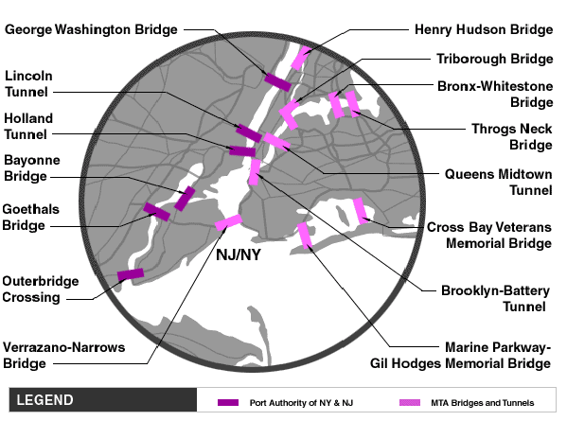
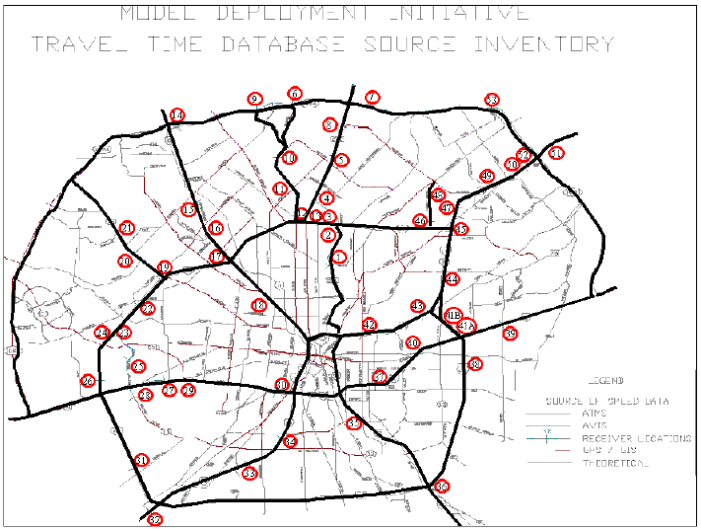
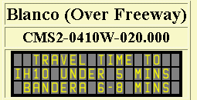
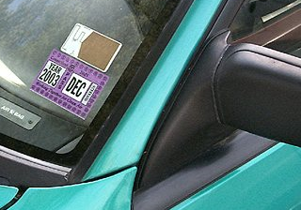

Additional Data Source 1: Automatic Vehicle Identification Data
Toll Facilities in the New York City Area
AVI Readers in San Antonio, TX
 | Identification rates | Market penetration rates
Active RFID tags | >99.9% | Low
Passive RFID tags | 75%-85% | Low
License plates | 40%-65% | 100%
Notes:
US cities with AVI deployments
Houston,
San Antonio,
New York City,
Phoenix,
Seattle…
RFID

Slide 11
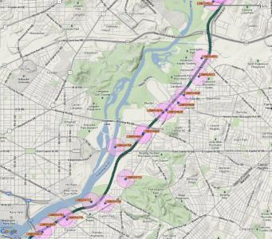
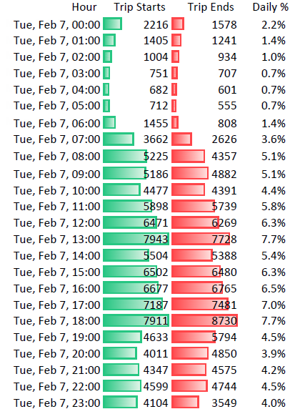
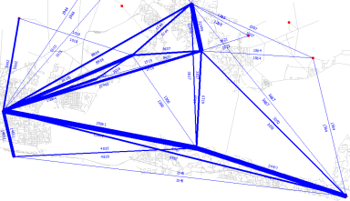
Additional Data Source 2: Cell Phone Data: e.g. Airsage
AirSage processes and archives a location each time a mobile device interacts with the network…
Start of Call
End of Call
Text Message
Data Transfers
Multiple hourly location update
Aggregate Population Movements (OD)

Slide 12
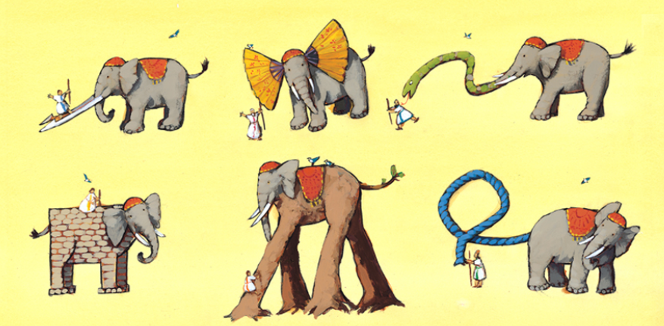
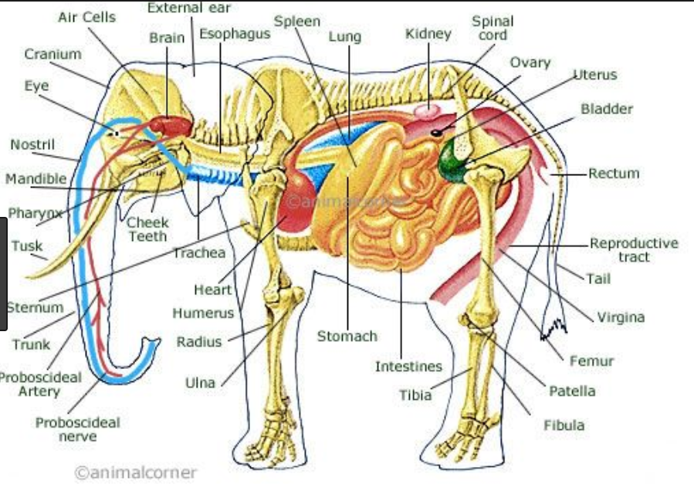
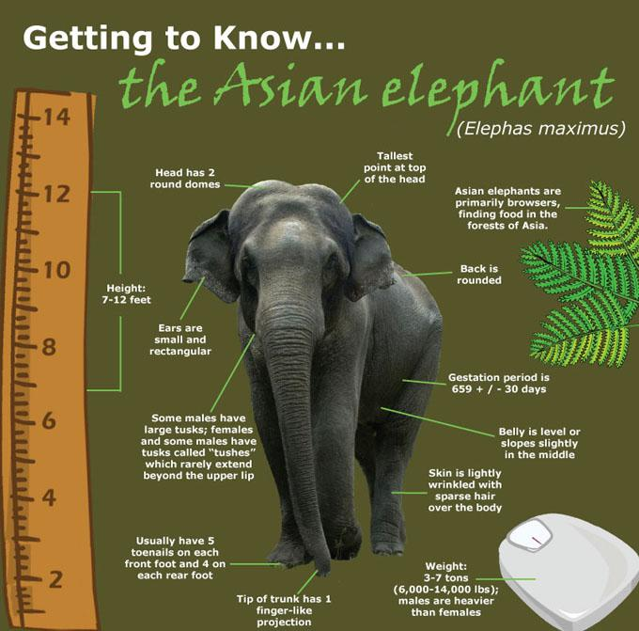
Do we still need analytical model?
Integrate domain knowledge with different traffic measurements
Automatic Vehicle Location
Domain knowledge from transportation modeling
Household
Surveys
Smart card data
Cell phone data
Social location data
Loop detector data
Network state of
a real transportation system

Slide 13
Why we integrate different types of data sources？
Residential Survey
3000 households; trip rate: 3.5
Number of trips 10,500
VOT: 20 dollar/hour
Sensor
Freeway: 6,500
Cell phone
Total number of records: 15,000
Split: Freeway 65%; Arterial 35%

Slide 14
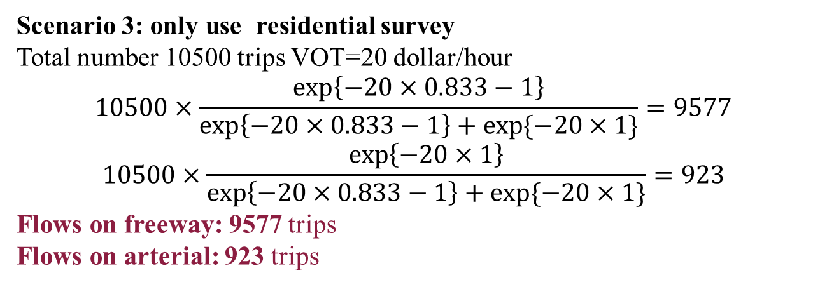
Why we integrate different types of data sources？
Which one is right?
Scenario 1 : only use cell phone data
Total number: 15000 trips
Split: Freeway 65%; Arterial 35%
Flows on freeway: 9750 trips
Flows on arterial: 5250 trips
Scenario 2 : only use sensor data
Flows on freeway: 6500 trips
(overfitting)
Scenario 3: only use residential survey
Total number 10500 trips VOT=20 dollar/hour
$$10500×\frac{\exp\left\{−20×0.833−1\right\}}{\exp\left\{−20×0.833−1\right\}+exp⁡\{−20×1\}}=9577$$
$$10500×\frac{\exp\left\{−20×1\right\}}{\exp\left\{−20×0.833−1\right\}+exp⁡\{−20×1\}}=923$$
Flows on freeway: 9577 trips
Flows on arterial: 923 trips

Slide 15
Why we integrate different types of data sources？
Comparison of different data sources
Characteristics | Household travel surveys | Mobile phone data | Automatic Vehicle Location data | Loop detector data
Time period | 5-10 years | Multi-hour periods within the day | individual hours of the day | Per 15 minutes of the day
Demand types | Aggregated and disaggregated | Aggregated | Aggregated sometime disaggregated traces | Aggregated
Sample penetration | Low | Depend on market share | Low | High
Spatial resolution | Household-based | 200m-2000m | 1-10m | Link-based
Spatial coverage | Zone-based, individuals | origin to destination | OD and path | Link
Wu, X., Guo, J., Xian, K., & Zhou, X. (2018). Hierarchical travel demand estimation using multiple data sources: A forward and backward propagation algorithmic framework on a layered computational graph. Transportation Research Part C: Emerging Technologies, 96, 321-346.

Slide 16
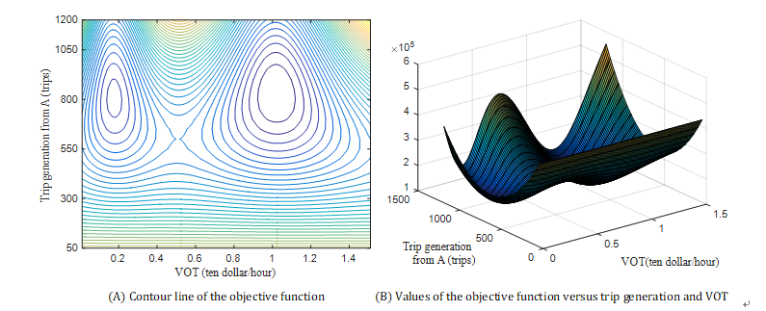
Is a combined analytical 4-step model easy to calibrate?
Traffic demand flow estimation (TDFE) problem (Simultaneous estimation problem of traffic demand flows and behavior coefficients)
Sequential step methods:
1. Linear regression model; Fundamental units
2. Gravity model; ODME problem
3. Traffic assignment/ Stochastic network loading
4. Discrete choice model
A. Usually only use single data sources for each step B. Sequential decisions without feedback
Different levels of demand variables
Data sources
Trip generation
Spatial distribution
Route choices
Behavioral utilities
Traditional Survey
Big data sources
Non convex
Hard to solve

Slide 17
What kinds of models do we need in the future?
Econometrics
Conventional
4-step method
Traditional Survey
Machine learning
Analytical model
Econometrics
Big data
Need a model
Machine learning
Econometrics
Traditional Survey
(Stream) Data driven model
Machine learning
Econometrics
Big data
Machine learning
Hi-tech Model of
Future?
Adapted from Mr.Peter Vovsha’s presentation at TRB Conference on Innovations in Travel Modeling (ITM), 2018
Do we need a pure analytical model or a data driven model, or a data-driven analytical model?
How big data with different data sources, in conjunction with traditional survey data, can be used to calibrate conventional 4-step model?
What is the relationship between classical econometric model and machine learning models? Can machine learning models be used to calibrate 4-step model?
Notes:
Slides, … source: TRB innovation conference. Ss… .
Do we need a pure analytical model or a data driven model, or a data driven analytical model?
How big data with different data sources, in conjunction with traditional survey data, can be used to calibrate conventional 4-step model?
What is the relationship between classical econometric model and machine learning models? Can machine learning models be used to calibrate 4-step model?

Slide 18
2. What is Deep Learning from our model calibration perspective?

Slide 19
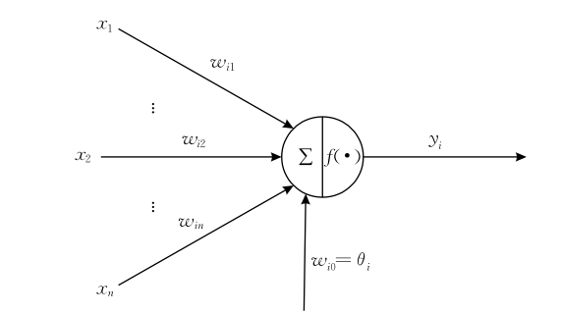
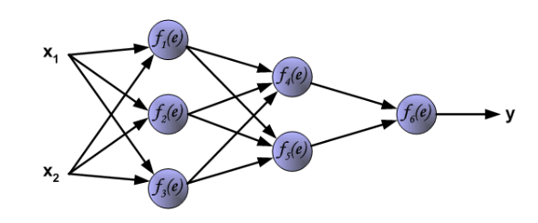

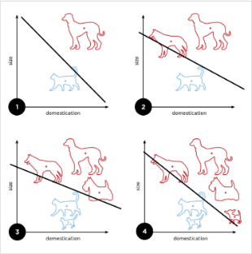
What can we learn from AI field?
1. Hierarchical structure of artificial neural networks
Brief history of deep learning
McCulloch-Pitts (1943)
Neuron of brain function
Rosenblatt
(1956)
Perceptron ADA-LINE
Stochastic gradient descent
Rumelhart et al.
(1986)
Multi-layer distributed representation
Back propagation algorithm
Hinton et al.
(2006)
The last ten years Convolutional networks
Figure source: http://galaxy.agh.edu.pl/~vlsi/AI/backp_t_en/backprop.html

Slide 20
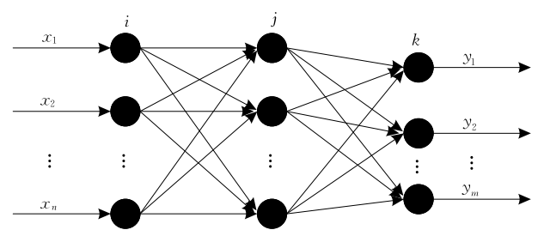
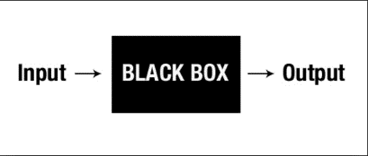

What can we learn from AI field?
Why cannot use deep learning directly?
Do not have Interpretability
Ground truth
3000 households; 3.333 trips/h
Number of trips: 10,000
66.15%: 6,615 trips on the freeway
33.85%: 3,385 trips on the arterial
Current toll: 1 dollar
VOT:10 dollar/h
Real-world travel time of freeway: 50 min
Real-world travel time of arterial: 60 min
If the toll increases to 2 dollars, how the demand will changes?
Toll: increases to $2
Now
Future

Slide 21
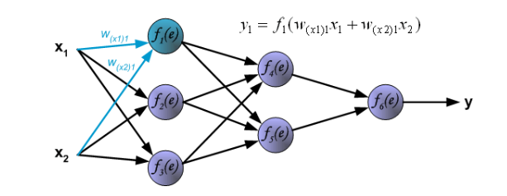
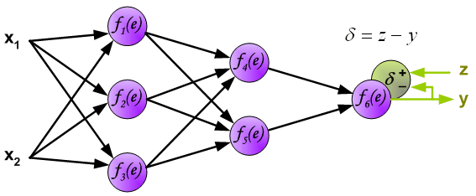
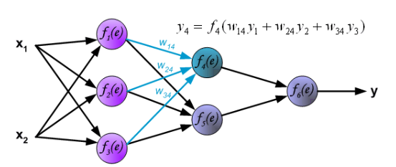
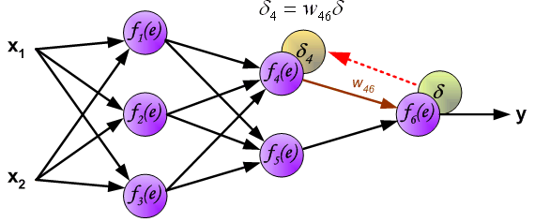
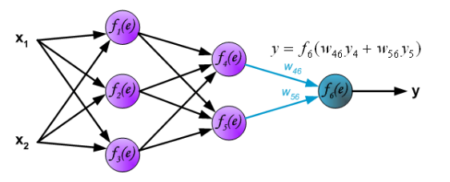
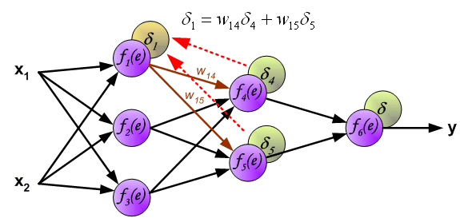
What can we learn from AI field?
2. Forward and Backward propagation
Forward propagation
Backward propagation
Source: http://galaxy.agh.edu.pl/~vlsi/AI/backp_t_en/backprop.html

Slide 22
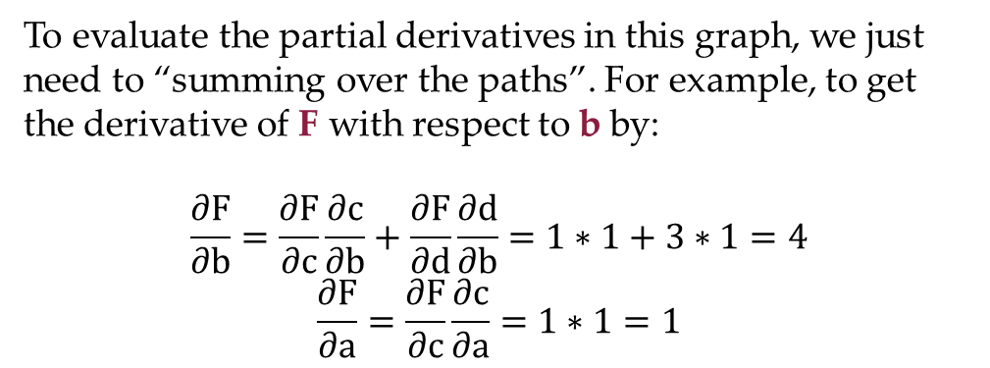
What can we learn from AI field?
3. Math foundation of neural network architecture:
Computational graph approach
Computational graph is a acyclic graph to express composite mathematical formulations
(A generalization of Artificial Neural Network )
Computational graph is a technique for calculating derivatives quickly
(A generalization of Back propagation algorithm)
To evaluate the partial derivatives in this graph, we just need to “summing over the paths”. For example, to get the derivative of F with respect to b by:
$$\frac{∂F}{∂b}=\frac{∂F}{∂c}\frac{∂c}{∂b}+\frac{∂F}{∂d}\frac{∂d}{∂b}=1∗1+3∗1=4$$
$$\frac{∂F}{∂a}=\frac{∂F}{∂c}\frac{∂c}{∂a}=1∗1=1$$
Adapted from ：http://colah.github.io/posts/2015-08-Backprop/

Slide 23
What can we learn from AI field?
3. One foundation for Deep Learning: Computational graph
Mode split models (driving alone vs. transit service) CAN ALSO BE EXPRESSED by a computational graph
$$P_{DA}=σ\left(U_{DA}−U_{TR}\right)=\frac{1}{1+\exp\left(U_{TR}−U_{DA}\right)}=\frac{1}{1+exp⁡(−β_{1}INC+β_{2}{TT}_{DA}−β_{2}{TT}_{TR})}$$
$$\frac{∂P_{DA}}{∂β_{2}}=\frac{∂P_{DA}}{∂d}\frac{∂d}{∂e}\frac{∂e}{∂u}\frac{∂u}{∂b}\frac{∂b}{∂β_{2}}+\frac{∂P_{DA}}{∂d}\frac{∂d}{∂e}\frac{∂e}{∂u}\frac{∂u}{∂c}\frac{∂c}{∂β_{2}}=\left({TT}_{TR}−{TT}_{DA}\right) σ\left(U_{DA}−U_{TR}\right)\left[1−σ\left(U_{DA}−U_{TR}\right)\right]$$

Slide 24
What kinds of DL models do we need in model calibration?
Simultaneous models to estimate different levels of traffic demands (trip generation, trip distribution, route choices etc.)
Data driven models that can integrate different data sources.
Explainable models that combine emerging AI technologies with domain knowledge in transportation modeling.
4. An iterative framework includes both a feed forward and feedback process.

Slide 25
3.What is layered computation graph?
A forward and backward propagation algorithmic framework on a layered computational graph

Slide 26
3.1 Hierarchical Flow Network (HFN) representation

Slide 27
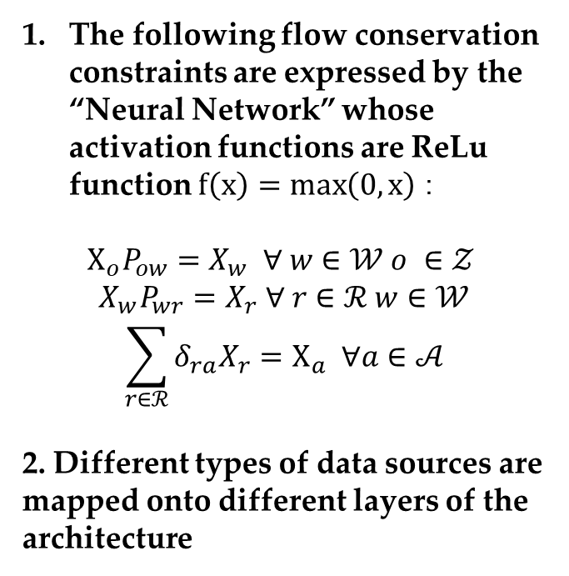
HFN representation in a explicit form
The following flow conservation constraints are expressed by the “Neural Network” whose activation functions are ReLu function $f\left(x\right)=\max\left(0, x\right)：$
$$X_{o}P_{ow}=X_{w} ∀ w∈𝒲 o ∈𝒵$$
$$X_{w}P_{wr}=X_{r} ∀ r∈ℛ w∈𝒲$$
$$\sum_{r∈ℛ}{δ_{ra}X_{r}}=X_{a} ∀a∈𝒜$$
2. Different types of data sources are mapped onto different layers of the architecture

Slide 28
Example of an HFN

Slide 29
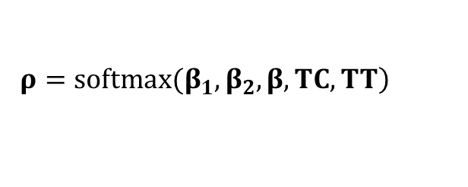
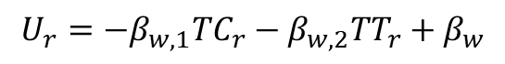
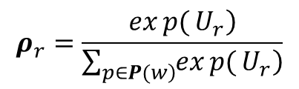
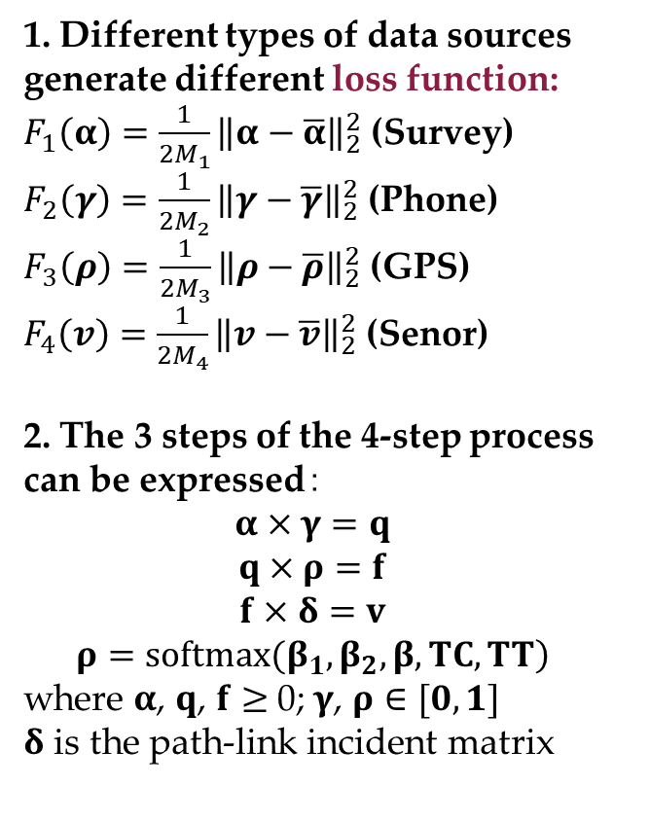
HFN representation in a vectorized form
1. Different types of data sources generate different loss function:
$F_{1}\left(α\right)=\frac{1}{2M_{1}}{\left\|α−\overline{α}\right\|}_{2}^{2}$ (Survey)
$F_{2}\left(γ\right)=\frac{1}{2M_{2}}{\left\|γ−\overline{γ}\right\|}_{2}^{2}$ (Phone)
$F_{3}\left(ρ\right)=\frac{1}{2M_{3}}{\left\|ρ−\overline{ρ}\right\|}_{2}^{2}$ (GPS)
$F_{4}\left(v\right)=\frac{1}{2M_{4}}{\left\|v−\overline{v}\right\|}_{2}^{2}$ (Senor)
2. The 3 steps of the 4-step process can be expressed$：$
$$α×γ=q$$
$$q×ρ=f$$
$$f×δ=v$$
$$\left.ρ=softmax(β_{1},β_{2},β, TC,TT\right)$$
where $α$, $q$, $f$ $≥$ 0; $γ$, $ρ∈[0,1]$
$δ$ is the path-link incident matrix
$$ρ_{r}=\frac{\left.exp{(}U_{r}\right)}{\sum_{\left.p∈P(w\right)}{\left.exp{(}U_{r}\right)}}$$
Multinomial logit model
( also known as SOFTMAX function in deep learning field)
In short
$$U_{r}=−β_{w,1}{TC}_{r}−β_{w,2}{TT}_{r}+β_{w}$$
Travel time of path r: TT_{r}
Travel cost of path r: TC_{r}
$$\left.ρ=softmax(β_{1},β_{2},β, TC,TT\right)$$

Slide 30
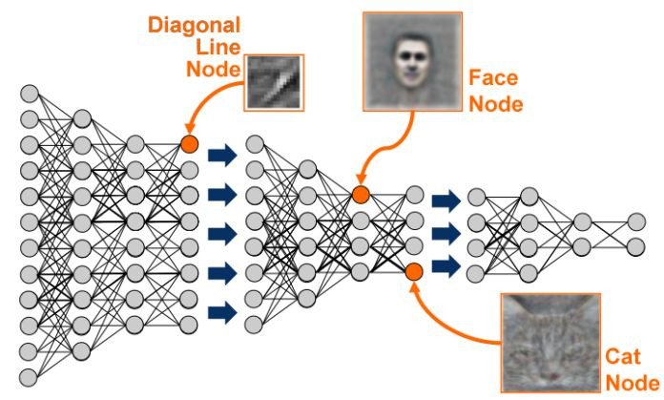
Compare HFN with Artificial Neural Networks
Similarity：
Hierarchy of the model
Transitivity (Error signals are
Forward and backward propagated on the network)
Differences:
Data are input on different layers in HFNs
Each “Neuron” has explainable traffic meaning

Slide 31
3.2 Big data driven Transportation Computational Graph (BTCG)

Slide 32
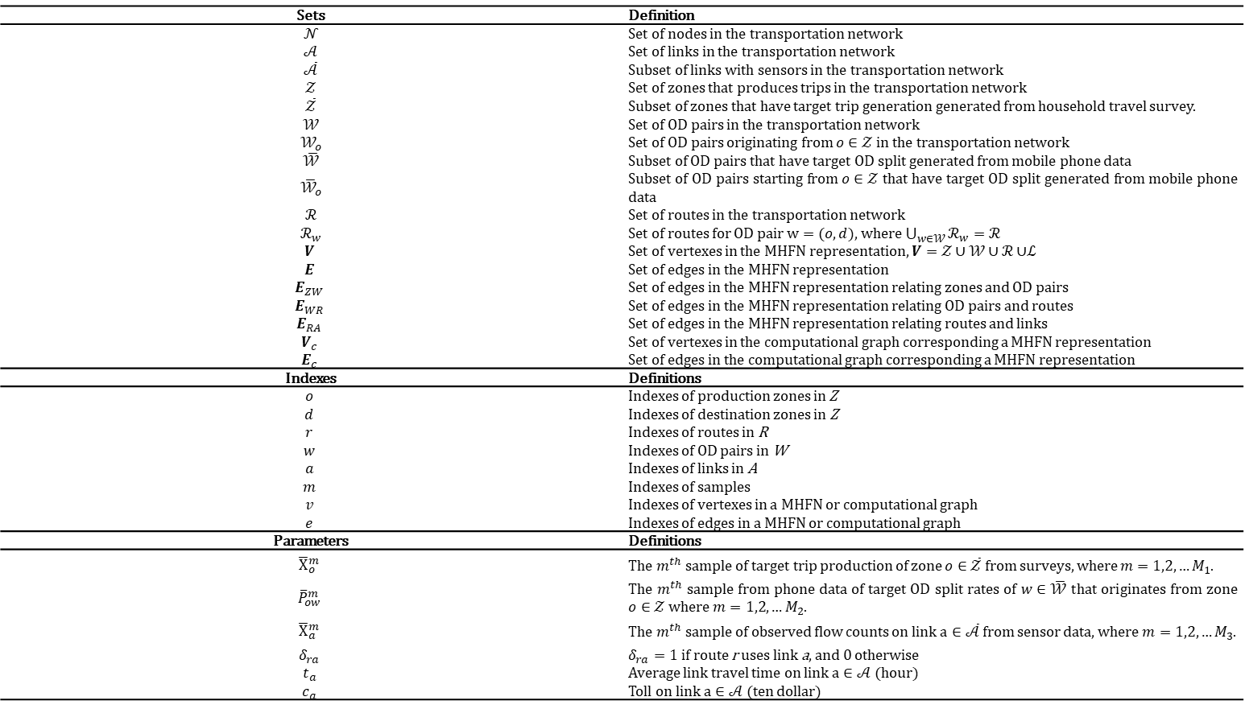
Problem statement
Notations:
Sets | Definition
 | Set of nodes in the transportation network
 | Set of links in the transportation network
 | Subset of links with sensors in the transportation network
 | Set of zones that produces trips in the transportation network
 | Subset of zones that have target trip generation generated from household travel survey.
 | Set of OD pairs in the transportation network
 | Subset of OD pairs that have target OD split generated from mobile phone data
 | Set of routes in the transportation network
 | Set of edges in the MHFN representation
 | Set of edges in the MHFN representation relating zones and OD pairs
 | Set of edges in the MHFN representation relating OD pairs and routes
 | Set of edges in the MHFN representation relating routes and links
 | Set of vertexes in the computational graph corresponding a MHFN representation
 | Set of edges in the computational graph corresponding a MHFN representation
Indexes | Definitions
 | Indexes of production zones in Z
 | Indexes of destination zones in Z
 | Indexes of routes in R
 | Indexes of OD pairs in W
 | Indexes of links in A
 | Indexes of samples
 | Indexes of vertexes in a MHFN or computational graph
 | Indexes of edges in a MHFN or computational graph
Parameters | Definitions
Traffic network
With hat →
with observed
traffic measurement
MHFN/ BTCG
o : origin
d: destination
r: route
a: link
m: sample
v ：vertex in MHFN/ BTCG
e : edges in MHFN/ BTCG
Samples from
Data sources

Slide 33
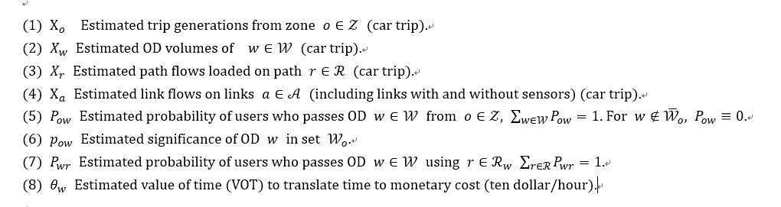
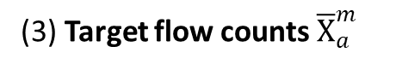
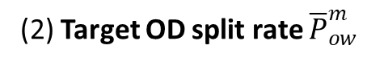
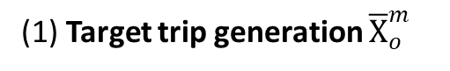
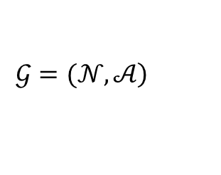
Problem statement
Model formulation
$$\left.𝒢=(𝒩,𝒜\right)$$
The index of samples
(1) Target trip generation ${\overline{X}}_{o}^{m}$
Observed traffic measures
(2) Target OD split rate ${\overline{P}}_{ow}^{m}$
(3) Target flow counts ${\overline{X}}_{a}^{m}$
Demand variables in different levels
Probability
Route choice
Behavior parameters

Slide 34
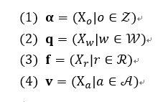
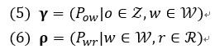
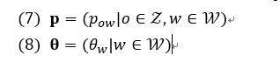
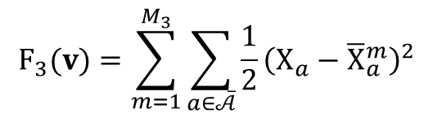
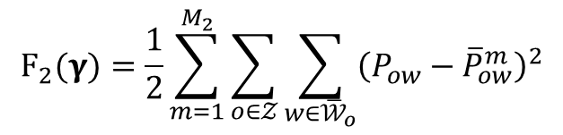
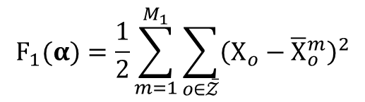
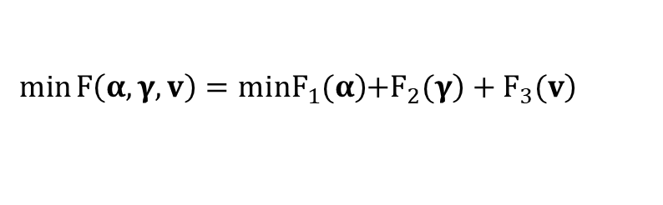
Problem statement
$$\left.min\left.F\left(α,γ,v\right)=minF_{1}(α\right)\left.+F_{2}(γ\right)+F_{3}(v\right)$$
$$F_{1}(α)=\frac{1}{2}\sum_{m=1}^{M_{1}}{\sum_{o∈\overline{𝒵}}{{\left(X_{o}−{\overline{X}}_{o}^{m}\right)}^{2}}}$$
$$F_{2}(γ)=\frac{1}{2}\sum_{m=1}^{M_{2}}{\sum_{o∈𝒵}{\sum_{w∈{\overline{𝒲}}_{o}}{{\left(P_{ow}−{\overline{P}}_{ow}^{m}\right)}^{2}}}}$$
Demand variables
$$F_{3}(v)=\sum_{m=1}^{M_{3}}{\sum_{a∈\overline{𝒜}}{\frac{1}{2}{\left(X_{a}−{\overline{X}}_{a}^{m}\right)}^{2}}}$$
Probability
Three objective function
1 Household travel survey
Population * trip rate
2 Mobile phone data
Target OD split
3 Sensor data
Behavior parameters

Slide 35













Problem statement
$$v=v\left(f\right)=v\left(f\left(q,ρ\right)\right)=v\left(\left.f(q\left(\left.α,γ(p\right)\right),ρ\left(θ\right)\right)\right)=α×γ(p)×ρ(θ)×δ$$
TDFE-UB Model
$$X_{a}=\sum_{ o∈𝒵}{\sum_{ w∈𝒲}{\sum_{r∈ℛ}{X_{o}P_{ow}P_{wr}δ_{ra}}}} ∀a∈𝒜$$
$$min F\left(α,γ,v\right)$$
$$X_{o}P_{ow}=X_{w} ∀ w∈𝒲 o ∈𝒵$$
Composite function, comprising of Non linear function
Non convex
$$P_{ow}=\left\{\begin{aligned}\frac{p_{ow} }{\sum_{w∈𝒲_{o}}{p_{ow}} }, &w∈𝒲_{o}, o∈Z \\ 0 , &w∉𝒲_{o}, o∈Z\end{aligned}\right.$$
$$min F\left(α,γ,v\right)$$
$$α×γ(p)=q$$
$$X_{w}P_{wr}=X_{r} ∀ r∈ℛ w∈𝒲$$
$$q×ρ(θ)=f$$
$$\sum_{r∈ℛ}{δ_{ra}X_{r}}=X_{a} ∀a∈𝒜$$
$$f×δ=v$$
$$P_{wr}=\left\{\begin{aligned}\frac{exp\left(−θ_{w}\sum_{a∈𝒜}{δ_{ra}t_{a}−\sum_{a∈𝒜}{δ_{ra}c_{a}}}\right)}{\sum_{r∈ℛ_{w}}{exp\left(−θ_{w}\sum_{a∈𝒜}{δ_{ra}t_{a}−\sum_{a∈𝒜}{δ_{ra}c_{a}}}\right)}}, &r∈ℛ_{w},w∈W \\ 0 , &r∉ℛ_{w},w∈W\end{aligned}\right.$$
$$\left.min\left.F\left(α,γ,v\right)=minF_{1}(α\right)\left.+F_{2}(γ\right)+F_{3}(v\left(\left.f(q\left(\left.α,γ(p\right)\right),ρ\left(θ\right)\right)\right)\right)$$

Slide 36


Problem statement
TDFE-UB Model
Non-convex

Slide 37

Reformulation using multi-layer hierarchical flow network representation
ReLU
Rectified linear unit

Slide 38

Reformulation using multi-layer hierarchical flow network representation
ReLU
Rectified linear unit: Why do not need Logistic sigmoid?
Logistic sigmoid
Drawbacks: saturate
ReLu
Advantage: Fast
universal approximation theorem
In the mathematical theory of artificial neural networks, the universal approximation theorem states^{[1]} that a feed-forward network with a single hidden layer containing a finite number of neurons (i.e., a multilayer perceptron), can approximate continuous functions on compact subsets of R^{n}, under mild assumptions on the activation function. T

Slide 39




Reformulation using multi-layer hierarchical flow network representation
Multi-commodity flow conservation constraints
$$X_{o}=\sum_{w∈𝒲_{o}}{X_{w}} ∀ o ∈𝒵$$
$$X_{w}=\sum_{r∈ℛ_{w}}{X_{r}} ∀ w∈𝒲$$
$$\sum_{ w∈𝒲}{\sum_{r∈ℛ_{w}}{δ_{ra}×X_{r}}}=X_{a} ∀a∈𝒜$$

Slide 40
Reformulation using multi-layer hierarchical flow network representation

Slide 41
Big data driven transportation computational graph to implement back propagation algorithm
(1) Forward passing
The forward passing process sequentially implements trip generation, trip distribution estimation, and route-based traffic assignment, which is an analogous process of the four-step approach in the field of traffic management.
(2) Backward propagation:
The back propagation process inversely implements a feedback control on the forward passing process. Different layers of first-order partial derivatives or “loss errors” are aggregated to calculate marginal gradients.
(3) Variable values update：
The estimation variables are updated using stochastic gradient descent using the marginal gradients.

Slide 42
Big data driven transportation computational graph to implement back propagation algorithm
Computational graph language to describe the back propagation

Slide 43
Big data driven transportation computational graph to implement back propagation algorithm
Computational graph language to describe the back propagation

Slide 44
Big data driven transportation computational graph to implement back propagation algorithm
Computational graph language to describe the back propagation

Slide 45



Big data driven transportation computational graph to implement back propagation algorithm
Computational graph language to describe the back propagation
$$\frac{\left.∂F_{3}(v\right)}{∂α}=\frac{\left.∂F_{3}(v\right)}{∂v}×\frac{∂v}{∂f}×\frac{∂f}{∂q}×\frac{∂q}{∂α}$$
$$\frac{\left.∂F_{3}(v\right)}{∂p}=\frac{\left.∂F_{3}(v\right)}{∂v}×\frac{∂v}{∂f}×\frac{∂f}{∂q}×\frac{∂q}{∂γ}×\frac{∂γ}{∂p}$$
$$\frac{\left.∂F_{3}(v\right)}{∂θ}=\frac{\left.∂F_{3}(v\right)}{∂v}×\frac{∂v}{∂f}×\frac{∂f}{∂ρ}×\frac{∂ρ}{∂θ}$$

Slide 46



Big data driven transportation computational graph to implement back propagation algorithm
Computational graph language to describe the back propagation
(1) Partial derivatives of loss functions with respect to estimation variables

Slide 47


Big data driven transportation computational graph to implement back propagation algorithm
Computational graph language to describe the back propagation
(2) Partial derivatives of a demand variable with respect to another demand variable

Slide 48



Big data driven transportation computational graph to implement back propagation algorithm
Computational graph language to describe the back propagation
(3) Partial derivatives of a demand variable with respect to a probability parameter

Slide 49


Big data driven transportation computational graph to implement back propagation algorithm
Computational graph language to describe the back propagation
(4) Partial derivatives of a probability parameter with respect to a behavior parameter

Slide 50
Computational graph language to describe the back propagation
Normalization layer

Slide 51
Logit layer
Computational graph language to describe the back propagation

Slide 52





Big data driven transportation computational graph to implement back propagation algorithm
Solution procedure to implement back propagation： exponent path from an input to an output
Let $V_{c}$ denote the set of vertexes in the computational graph corresponding to MHFN $G(V, A)$ (or the common term “state” in dynamic programming). $A_{c}$ implies the set of edges in the computational graph corresponding to MHFN Bound conditions is set on the vertexes served as interface between data sources and the computational graph $G_{c}(V_{c}, A_{c})$. Let $V_{c}^{B}⊂V_{c}$ be the set of bound vertexes.
Dynamic programming
Bound condition: interface to data sources
$$\frac{∂F}{∂v}=1, ∀v∈V_{c}^{B}$$
State transition function
$$\frac{∂F}{∂v}=\sum_{\left.v′∈△^{+}(v\right)}{\frac{∂F}{∂v′}}\frac{∂v′}{∂v}$$
Comparison
$F_{j}$ = $\min_{i′∈△^{−}(j)}{(t_{ij}+F_{i})}$ shortest path

Slide 53
Backpropagation Algorithm
History
Backpropagation is a method to calculate the gradient of the loss function with respect to the weights in an artificial neural network.
Backpropagation were derived in the context of control theory by Herry K. Kelley in 1960 and by Arthur E. Bryson in 1961, using principles of dynamic programming.
Intuition
Learning as an optimization problem.
Limitations
Gradient descent with backpropagation is not guaranteed to find the global minimum of the error function.

Slide 54
Big data driven transportation computational graph to implement back propagation algorithm
Solution procedure to implement back propagation
Let $V_{c}$ denote the set of vertexes in the computational graph corresponding to MHFN $G(V, A)$ (or the common term “state” in dynamic programming). $A_{c}$ implies the set of edges in the computational graph corresponding to MHFN Bound conditions is set on the vertexes served as interface between data sources and the computational graph $G_{c}(V_{c}, A_{c})$. Let $V_{c}^{B}⊂V_{c}$ be the set of bound vertexes.
Dynamic programming
Bound condition: interface to data sources
$$\frac{∂F}{∂v}=1, ∀v∈V_{c}^{B}$$
State transition function
$$\frac{∂F}{∂v}=\sum_{\left.v′∈△^{+}(v\right)}{\frac{∂F}{∂v′}}\frac{∂v′}{∂v}$$
Comparison
$F_{j}$ = $\min_{i′∈△^{−}(j)}{(t_{ij}+F_{i})}$ shortest path

Slide 55

Backpropagation Algorithm
Chain rule
of derivatives

Slide 56


Solution procedure to implement back propagation
Normalization
Bound conditions
Euler algorithm
Stochastic Gradient descendent

Slide 57




Solution procedure to implement back propagation
Batch Gradient Descent
Stochastic Gradient Descent
Mini-batch Gradient Descent
Euler algorithm
Stochastic Gradient descendent

Slide 58



Solution procedure to implement back propagation
(1) Vanishing gradient problem in BTCG
$$\frac{\left.∂F_{3}(v\right)}{∂α}=\frac{\left.∂F_{3}(v\right)}{∂v}×\frac{∂v}{∂f}×\frac{∂f}{∂q}×\frac{∂q}{∂α}$$
Small values within range [0,1]
(2) Exploding gradient problem in BTCG
$$\frac{∂F_{3}(v)}{∂p}=\frac{∂F_{3}(v)}{∂v}×\frac{∂v}{∂f}×\frac{∂f}{∂q}×\frac{∂q}{∂γ}×\frac{∂γ}{∂p}$$
$$\frac{∂F_{3}(v)}{∂θ}=\frac{∂F_{3}(v)}{∂v}×\frac{∂v}{∂f}×\frac{∂f}{∂ρ}×\frac{∂ρ}{∂θ}$$
Large values equal to OD volume or trip production
$$φ_{3}≫φ_{2}>φ_{1}$$

Slide 59


Extend an HFN to a computational graph
Big data driven Transportation Computational Graph (BTCG)
Q1: How sensor data impact behavioral coefficients?
$$\frac{\left.∂F_{4}(v\right)}{∂β}=\frac{\left.∂F_{4}(v\right)}{∂v}\frac{∂v}{∂f}\frac{∂f}{∂ρ}\frac{∂ρ}{∂β}$$
Q2: How parameter $γ$ is calibrated by different two kinds of traffic measurements?
（1）$\frac{\left.∂F_{4}(v\right)}{∂γ}=\frac{\left.∂F_{4}(v\right)}{∂v}\frac{∂v}{∂f}\frac{∂f}{∂q}\frac{∂q}{∂γ}$
（2）$\frac{\left.∂F_{2}(γ\right)}{∂γ}$

Slide 60
Big data driven transportation computational graph to implement back propagation algorithm
Forward passing
The forward passing process sequentially implements trip generation, trip distribution estimation, and route-based traffic assignment, which is an analogous process of the four-step approach in the field of traffic management.
(2) Backward propagation:
The back propagation process inversely implements a feedback control on the forward passing process. Different layers of first-order partial derivatives or “loss errors” are aggregated to calculate marginal gradients.
(3) Variable values update：
The estimation variables are updated using stochastic gradient descent using the marginal gradients..

Slide 61


Big data driven transportation computational graph (BTCG) to implement back propagation algorithm
Automatic differentiation (AD) is a method to calculate the derivatives of the loss function with respect to the demand variables in a BTCG .
Derivatives were derived in a computational graph, using principles of dynamic programming (DP) (like calculating the shortest path using label correcting algorithm).
Gradient descent with Back Propagation (BP) algorithm is not guaranteed to find the global minimum of the error function. However, multi-sample-based stochastic gradient descent (SGD) can be used to overcome the limit to some extent.
“AD+DP+BP” can be achieved easily using existing popular data programming tools such as TensorFlow, Theano etc.
An illustrative computational graph from:
https://www.tensorflow.org/guide/graphs?hl=zh-cn

Slide 62


Carefully determine the step sizes in Stochastic Gradient Descent
(1) Vanishing gradient problem in BTCG
$$\frac{\left.∂F_{3}(v\right)}{∂α}=\frac{\left.∂F_{3}(v\right)}{∂v}×\frac{∂v}{∂f}×\frac{∂f}{∂q}×\frac{∂q}{∂α}$$
Big data driven Transportation Computational Graph (BTCG)
Small values within range [0,1]
(2) Exploding gradient problem in BTCG
$$\frac{∂F_{4}(v)}{∂γ}=\frac{∂F_{3}(v)}{∂v}×\frac{∂v}{∂f}×\frac{∂f}{∂q}×\frac{∂q}{∂γ}$$
$$\frac{∂F_{4}(v)}{∂ρ}=\frac{∂F_{3}(v)}{∂v}×\frac{∂v}{∂f}×\frac{∂f}{∂ρ}$$
Large values equal to OD volume or trip production

Slide 63
4. Steps for integrating ML/CG in 4-step model calibration
Numerical Examples

Slide 64
Case study: Sioux Falls network
Survey data(5 samples)
Cell phone data(20 samples)
Floating car data(7 samples)
Sensor data(13 samples)
Convergence curves

Slide 65
5.Simultaneous Forecasting Using an Econometric Model and Deep Neural Network
Ride-hailing and Existing Mobility Services in New York City
Coauthors: Tae Hooie Kim, Ram Pendyala

Slide 66

Motivation: Ride-hailing and Existing Mobility
Three Years Total Trips Transition in Murray Hill, Manhattan
 | Market Segment
Mobility Service | Yellow Taxi | For-hire Vehicle
2015 | 84.65 % | 15.35 %
2016 | 73.11 % | 26.89 %
2017 | 64.19 % | 35.81 %
170: Murray Hill

Slide 67






Framework: Simultaneous Forecasting Model
Problem: Forecasting the existing
& new mobility service simultaneously
Data: Yellow Taxi, For-hire Vehicle (FHV), Time, Weather, and Holiday
1
Model A: Multivariate Linear Regression
2
Model B: Long Short-term Memory (LSTM) NN
Interpreting & Estimating Unknown Parameters
Training the Residual Patterns
Model A:
Predicting Linearity
Model B:
Predicting Non-linearity
3
A + B = Demand for Yellow Taxi & FHV with Policy Indicators

Slide 68

Model A: Multivariate Linear Regression
The linear regression model can explain the linear relationship, but there is a limitation on capturing non-linear pattern.. (Based on R-squared, the model can only cover 37.2% or 57.3%)
To cover the residues, we send the data into the Neural Network (Model B)
Multivariate Linear Regression (FHV)
Variables | Estimate | (t-stat)
Constant | 0.6342 | (31.418)
Monday | 0.0121 | (1.212)
Tuesday | 0.0943 | (9.077)
Wednesday | 0.1399 | (12.915)
Thursday | 0.1995 | (17.320)
Friday | 0.2089 | (18.553)
Saturday | 0.0801 | (8.111)
Sunday | -0.1005 | (-9.859)
Yellow Taxi | -0.6071 | (-17.721)
Snow | -0.0349 | (-9.062)
Precipitation | 0.1833 | (4.753)
Holiday | -0.3063 | (-10.150)
R-squared | 0.372
Observations | 931
Multivariate Linear Regression (Yellow Taxi)
Variables | Estimate | (t-stat)
Constant | 0.6975 | (94.666)
Monday | 0.0302 | (3.672)
Tuesday | 0.1181 | (14.523)
Wednesday | 0.1620 | (19.768)
Thursday | 0.2183 | (26.166)
Friday | 0.2112 | (24.935)
Saturday | 0.0666 | (8.122)
Sunday | -0.1089 | (-13.354)
FHV | -0.4192 | (-17.721)
Snow | -0.0343 | (-9.06)
Precipitation | - | -
Holiday | -0.3406 | (-14.229)
R-squared | 0.573
Observations | 931
Unknown Parameters Interpretation
Explainable Variables |  | Demand
 |  | FHV | Taxi
Time | Weekday
 | Weekend
Weather | Rainy |  | -
 | Snow
Holiday
Relationship |  | -0.6071 (Yellow) | -0.4192 (FHV)

Slide 69

Model B: Long-short Term Memory Neural Network
Target
Loss
Estimated
Fully Connected Layer
Dataset
LSTM
LSTM
. . . .
LSTM
Forward Propagation
Backward Propagation
. . . .
LSTM
[[[Residual - Day1],
[Residual - Day2],
. . . .
[Residual - Day7]]]

Slide 70
Model B: Training Data and Test Data
Training Data: 85%
Test: 15%

Slide 71

A + B $→$ Forecasting the Demand on FHV
Interpretability
Predictability
Multivariate Linear Regression (FHV)
Variables | Estimate | (t-stat)
Constant | 0.6342 | (31.418)
Monday | 0.0121 | (1.212)
Tuesday | 0.0943 | (9.077)
Wednesday | 0.1399 | (12.915)
Thursday | 0.1995 | (17.320)
Friday | 0.2089 | (18.553)
Saturday | 0.0801 | (8.111)
Sunday | -0.1005 | (-9.859)
Yellow Taxi | -0.6071 | (-17.721)
Snow | -0.0349 | (-9.062)
Precipitation | 0.1833 | (4.753)
Holiday | -0.3063 | (-10.150)
R-squared | 0.372
Observations | 931
Test Data
A+B Model

Slide 72

Model Performance and Comparison
Christmas
Thanksgiving
Labor
$±$ 10%
New Year’s Eve
 | ARIMA | LSTM | ARIMA+LSTM | MLR + LSTM (A+B)
RMSE | 663.1348 | 460.1567 | 353.5828 | 467.3608
MAPE | 8.1178 | 5.8335 | 4.5204 | 4.8624
R-squared | 0.5915 | 0.7652 | 0.8520 | 0.8060
Min Error(%) | -26.06 | -20.25 | -20.91 | -23.23
Max Error(%) | 86.85 | 63.04 | 47.58 | 49.83

Slide 73
6.Further extensions

Slide 74
Further extensions
1. Extend our computational graph framework for Multi-day learning and dynamic traffic systems. 2. Extend our computational graph framework to activity-based models. 3. Capture behavioral causes by incorporating more complex choice models. 4. Improve computational capability using distributed computational graph to speed up the algorithm.

Slide 75
Further extensions
Data-driven traffic decision-making and management system for departments of transportation (DOT) and Metropolitan Planning Organizations (MPO) in future

Slide 76

Our paper:
Wu, X., Guo, J., Xian, K., & Zhou, X. (2018). Hierarchical travel demand estimation using multiple data sources: A forward and backward propagation algorithmic framework on a layered computational graph. Transportation Research Part C: Emerging Technologies, 96, 321-346.
https://www.researchgate.net/publication/325131295_Hierarchical_travel_demand_estimation_using_multiple_data_sources_A_forward_and_backward_propagation_algorithmic_framework_on_a_layered_computational_graph
Our codes:
For educational and research purposes, one can find the Matlab and Python source code for small networks at https://github.com/xzhou99/BTCG.
Supported from NSF CMMI#1538569, Improving Spatial Observability of Dynamic Traffic Systems
Notes:
https://www.nsf.gov/awardsearch/showAward?AWD_ID=1538569z

Slide 77
Thanks Questions?

